Slide 1
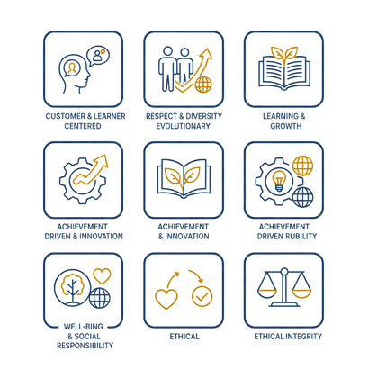



Core Value
WE CARE
Well-being
& social
responsibility
Ethical integrity
Customer
& learner centered
Achievement driven
& innovation
Respect
& diversity
Evolutionary learning
& growth

Slide 2


Core Value
WE CARE
Well-being
& social
responsibility
Ethical integrity
Customer
& learner centered
Achievement driven
& innovation
Respect
& diversity
Evolutionary learning
& growth

Slide 3

Core Value
WE CARE
Well-being
& social
responsibility
Ethical integrity
Customer
& learner centered
Achievement driven
& innovation
Respect
& diversity
Evolutionary learning
& growth

Slide 4

Core Value
WE CARE
Well-being
& social
responsibility
Ethical integrity
Customer
& learner centered
Achievement driven
& innovation
Respect
& diversity
Evolutionary learning
& growth

Slide 5
Core Value
WE CARE
Well-being
& social
responsibility
Ethical integrity
Customer
& learner centered
Achievement driven
& innovation
Respect
& diversity
Evolutionary learning
& growth

